Slide 1
MGT 608 – Information and Supply Chain Systems
Week 4, Lesson 2
Supply Chain Management

Slide 2
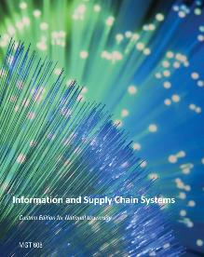
Preview of Week 4
Chapter 11: Transportation
Chapter 12: Supply Chain Management

Slide 3

Review of Facility Location

Slide 4
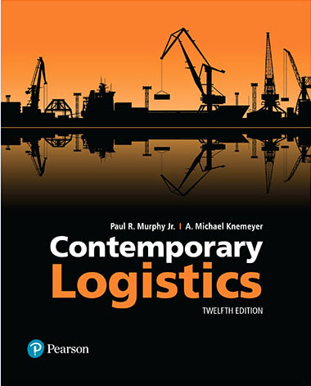
Contemporary Logistics
Twelfth Edition
Chapter 12
The Supply Chain Management Concept
Copyright © 2018, 2015, 2011 Pearson Education, Inc. All Rights Reserved.

Slide 5
Learning Objectives
1 To explain the concept of supply chains and how the network of inter-organizational relationships is managed
2 To summarize supply chain process frameworks
3 To illustrate potential enablers of supply chain management implementation
4 To illustrate potential barriers to supply chain management implementation
5 To compare optional approaches for supply chain integration
6 To understand the evolution of Supply Chain Management from its roots in Logistics.
7 To understand the role of technology in success of Supply Chain Management.
8 To distinguish the difference from business functions and business processes.
9 To explain the implementation of the Partnership Model and its six business relationship types.
10 To consider future innovations to further enhance effectiveness and efficiency through the continued evolution of Supply Chain Management.
Notes:
Slide 2 is list of textbook LO numbers and statements

Slide 6
Evolution of Supply Chain Management (1 of 7)
Relatively young concept—rarely mentioned prior to 1990
Recognition grew when value could be found in coordinating various business functions
SCM philosophy:
  Coordinate not only within organizations, but also across organizations
  Cross-functional → Inter-firm

Slide 7
Definition of Supply Chain Management (2 of 7)
A supply chain can be liberally viewed as a combination of processes, functions, activities, relationships, and pathways along which products, services, information, and financial transactions move in and between enterprises from original producer to ultimate end-user or consumer.¹
¹John Gattorna, “Supply Chains Are the Business,” Supply Chain Management Review 10, no. 6 (2006): 42–49.

Slide 8

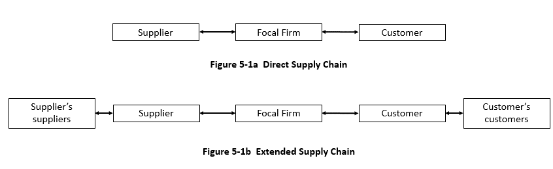
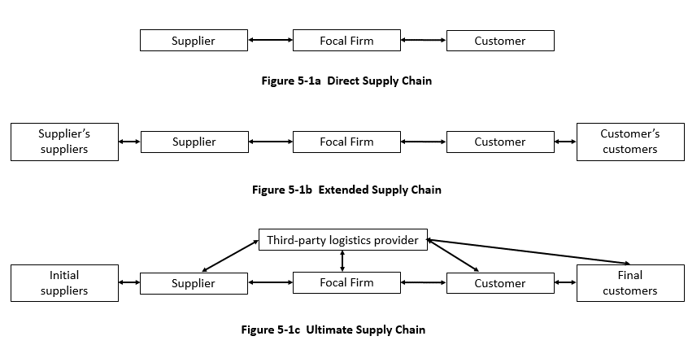
Figure 1: Different Supply Chain Configurations

Slide 9
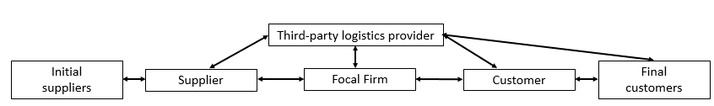
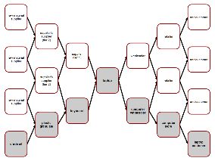

Evolution of Supply Chain Management (3 of 7)
Supply chains
  Some are more complex than others
  Customers are an integral component regardless of complexity level
Is a “chain” a good analogy?
A supply “network” is probably a better term!

Slide 10
Evolution of Supply Chain Management (6 of 7)
Successful supply chains
  Adopt an enterprise-to-enterprise point of view
  Adopt behaviors that haven’t traditionally been associated with buyer–seller interactions
Joint planning
Information sharing
Collaborative development
etc.
Logistics is where companies trade goods, therefore the primary interface between companies was the foundation to evolve SCM.

Slide 11
Evolution of Supply Chain Management (7 of 7)
Successful supply chains
  Apply a systems approach across all organizations in the supply chain
    Interdependencies
    Shared goals

Slide 12
Supply Chain Management Process Frameworks (1 of 6)
Two prominent models
  Supply Chain Operations Reference (SCOR) model
  Global Supply Chain Forum (GSCF) model
A primary distinction between the models is the degree of cross-functional involvement prescribed by each:
  GSCF involves all business functions
    More strategic focused
  SCOR model focuses on the logistics, operations, and procurement functions
    More operational focused

Slide 13
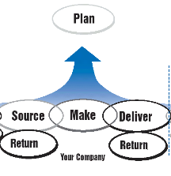
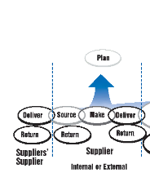
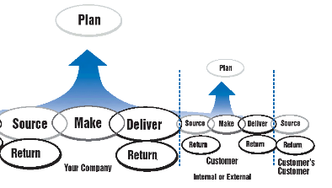
Supply Chain Management Process Frameworks (2 of 6)
Logistics and SCOR model
  Logistics in both sourcing and making
  Logistics in delivering and returning

Slide 14
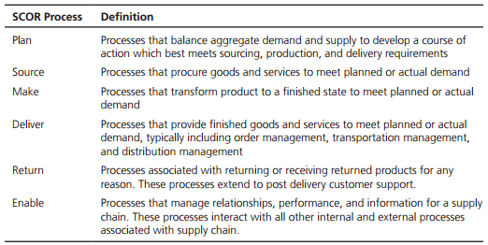
Table 1: Six Processes in the APICS Supply Chain Operations Reference (SCOR) Model
Source: APICS SCOR Model, Chicago, IL: APICS (www.apics.org)

Slide 15
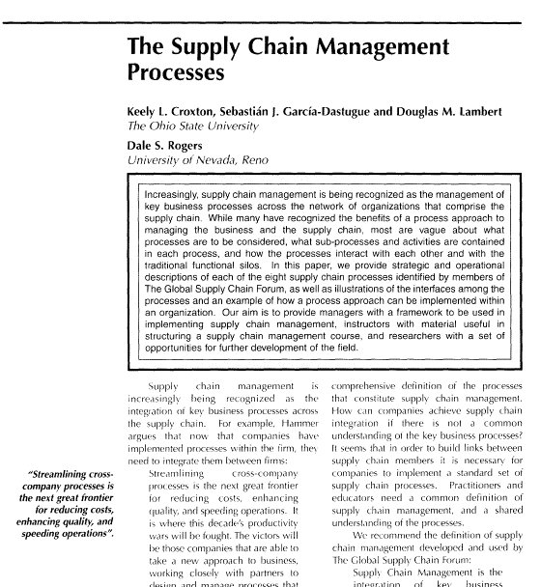

Slide 16
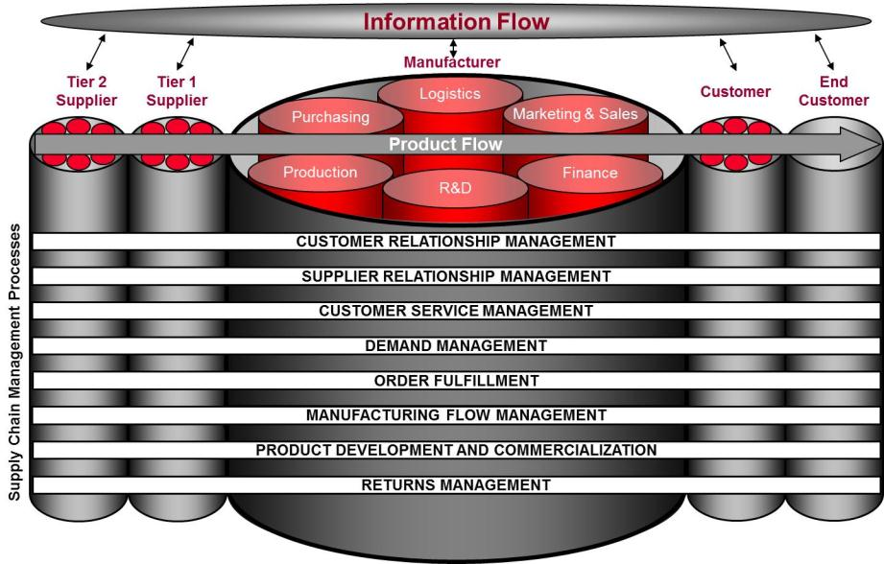
Supply Chain Management
Integrating and Managing Business Processes Across the Supply Chain
The world as it should be.
Source: Douglas M. Lambert, Editor, Supply Chain Management: Processes, Partnerships, Performance, Fourth Edition, Ponte Vedra Beach, FL: Supply Chain Management Institute, 2014, p. 3.

Slide 17
Processes Need to Be Standardized to Avoid Disconnects
Information Flow
Tier 2
Tier 1
Manufacturer
Supplier
Supplier
Logistics
Customer
Consumer/
Purchasing
Marketing
End
user
PRODUCT FLOW
Production
R&D
Finance
CUSTOMER RELATIONSHIP MANAGEMENT
SUPPLIER RELATIONSHIP MANAGEMENT
CUSTOMER SERVICE MANAGEMENT
DEMAND MANAGEMENT
ORDER FULFILLMENT
MANUFACTURING FLOW MANAGEMENT
The world as it really is!
PRODUCT DEVELOPMENT AND COMMERCIALIZATION
RETURNS MANAGEMENT
Source: Douglas M. Lambert, Editor, Supply Chain Management: Processes, Partnerships, Performance, Fourth Edition, Ponte Vedra Beach, FL: Supply Chain Management Institute, 2014, p. 14.

Slide 18
Types of Inter-company Business Process Links
Tier 3 to
Initial Suppliers
Tier 2
Suppliers
Tier 1
Suppliers
Tier 1
Customers
Tier 2
Customers
Tier 3 to
End Customers
Initial Suppliers
Tier 3 to n Suppliers
End Customers
1
1
2
2
n
1
n
1
1
2
n
2
1
1
Tier 3 to n Customers
3
2
3
1
n
3
n
n
n
n
1
1
2
1
n
n
n
Managed Process Links
Focal Company
Monitored Process Links
A supply chain is a network!
Members of the Focal Company’s Supply Chain
Not-Managed Process Links
Non-Member Process Links
Non-members of the Focal Company’s Supply Chain
Source: Douglas M. Lambert, Editor, Supply Chain Management: Processes, Partnerships, Performance, Fourth Edition, Ponte Vedra Beach, FL: Supply Chain Management Institute, 2014, p. 264.

Slide 19
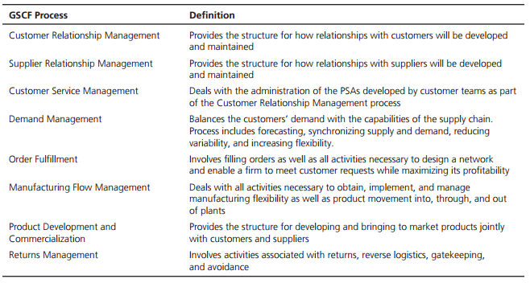
Table 2: Eight Processes in the Global Supply Chain Forum (GSCF) Model
Source: Douglas M. Lambert, Editor, Supply Chain Management: Processes, Partnerships, Performance, 4th ed. (Ponte Vedra Beach, FL: Supply Chain Management Institute, 2014), pp. 10–13. (www.scm-institute.org)

Slide 20
Enablers of SCM Implementation (1 of 22)
Customer power
Relationship structure
Leveraging technology
Supply chain facilitators
Details to follow…

Slide 21
Enablers of SCM Implementation (2 of 22)
Increased customer power:
  Customer has gained tremendous power over buying decisions
  Customer needs and wants can change relatively quickly
  Internet allows the consumer to become highly knowledgeable about:
    An individual organization and its products
    Competing organizations and their products

Slide 22
Enablers of SCM Implementation (5 of 22)
Increased customer power:
  Traditional supply chains
    Factory-driven, push-oriented
    Focused on internal cost metrics (measures) such as labor costs and freight costs
  Customer-centric supply chains
    Pull-oriented
    Concerned with metrics that take a more holistic perspective

Slide 23
Enablers of SCM Implementation (6 of 22)
Increased customer power:
  Perfect order:
    Simultaneous achievement of relevant customer metrics such as on-time delivery, damage free, and correct order quantity
    Examines the total impact of an incorrect order in a single metric via a multiplier effect
    Metric has been shown to help diagnose problems within a supply chain and improve satisfaction
    Looks at orders from the customer’s perspective

Slide 24
Enablers of SCM Implementation (7 of 22)
Increased customer power:
  Firms must focus on both effectively and efficiently designing their supply chains according to market needs/characteristics
    Agile supply chain may be most appropriate where customer demand is volatile and their requirements for variety are high
    Lean supply chain may be a more appropriate goal when customer demand is relatively stable and the need for variety is low
Same-day delivery services in select markets (…or faster!)

Slide 25

Enablers of SCM Implementation (8 of 22)
Understanding the implications of increased customer power
  Leagility
    Hybrid approach that combines aspects of both lean and agile
    Focus part of one’s supply chain on a timely response to fluctuating customer orders and/or product variety and
    Another part of the supply chain on leveling out the planning requirements to smooth production output
Importance of the Customer Lifespan

Slide 26

Enablers of SCM Implementation (11 of 22)
Relationship structures:
  Companies should consider employing a long-term as opposed to a short-term orientation with key supply chain members:
    Suppliers
    Customers
    Intermediaries
    Facilitators

Slide 27

Enablers of SCM Implementation (12 of 22)
Relationship structures:
  Long-term orientation tends to be predicated on relational exchanges
    “What’s in it for us?” philosophy
  Short-term orientation tends to focus on transactional exchanges
    “What’s in it for me?” philosophy

Slide 28
Enablers of SCM Implementation (13 of 22)
Relationship structures:
  Attributes of relational exchange:
    Trust
    Commitment
    Dependence
    Joint investment
    Shared benefits
    Shared risks

Slide 29
Enablers of SCM Implementation (14 of 22)
Relationship structures:
  Supply chain collaboration:
    relationships between members of a supply chain—formal or informal—between companies and their suppliers or customers, established to enhance the overall business performance of all parties

Slide 30
Enablers of SCM Implementation (15 of 22)
Relationship structures:
  Supply chain collaboration
    Can be classified as transactional, tactical information sharing, or strategic in nature
  Transactional and tactical information sharing are currently the most prevalent types of collaboration
  Strategic collaborations are increasing and offer the best opportunity for improving supply chain performance

Slide 31
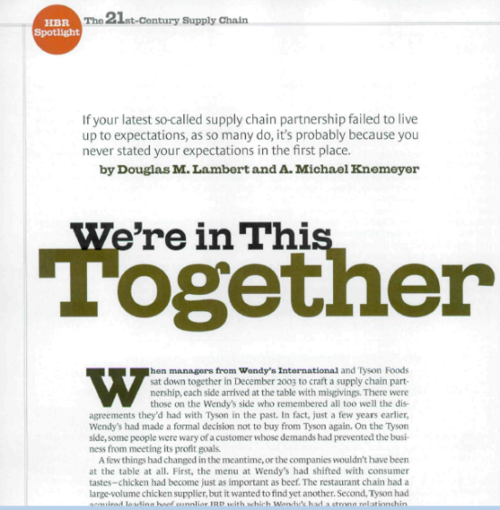

Slide 32

The Partnership Model
Top 5 List
of Things I Have Learned Using the Model
Thanks to Dr. Michael Knemeyer
The Ohio State Univ
https://hbr.org/2004/12/were-in-this-together

Slide 33

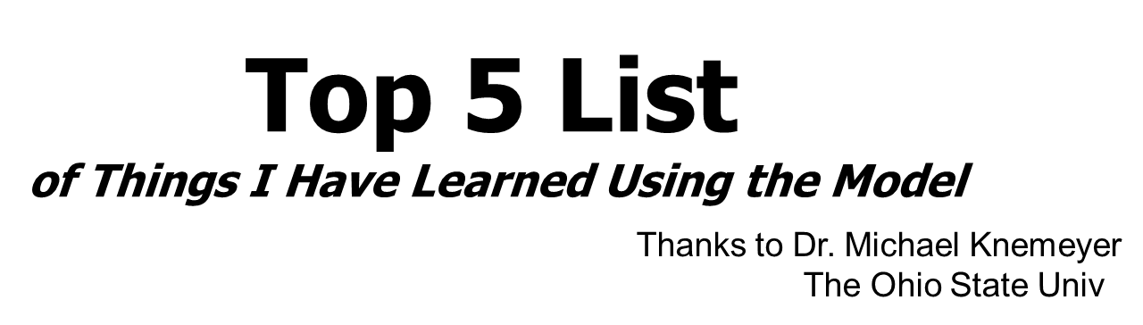
#5 Lesson Learned
You must be willing to look at things differently.

Slide 34

#4 Lesson Learned
Most companies have a lot more in common than they think.

Slide 35

#3 Lesson Learned
Visibility is key to building trust.

Slide 36
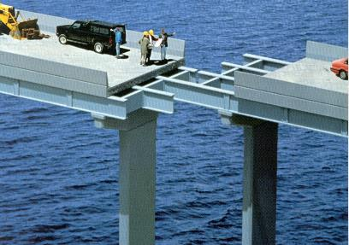
#2 Lesson Learned
Mistakes happen, the problem is not learning from them.

Slide 37
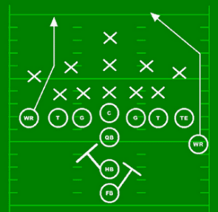
#1 Lesson Learned
A well structured plan that is closely monitored is key for ensuring results.

Slide 38

Chapter 15
Developing and Implementing Partnerships in the Supply Chain
Appreciations for material provided by
Dr. Mike Knemeyer
Supply Chain Management: Processes, Partnerships, Performance
4th Edition

Slide 39

Close your eyes and picture a boat.

Slide 40




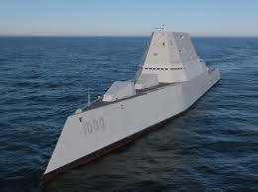


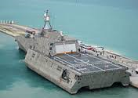


Slide 41

Partnership?

Slide 42
PARTNERSHIP - DEFINITION
A partnership is a tailored business relationship based on mutual trust, openness, shared risk and shared rewards that results in business performance greater than would be achieved by two firms working together in the absence of partnership.

Slide 43
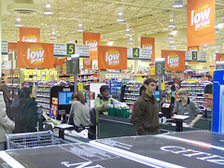

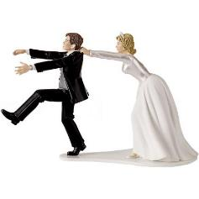
TYPES OF RELATIONSHIPS
Partnerships
Arm’s Length
Type I
Type II
Type III
Joint
Ventures
Vertical
Integration

Slide 44
WHY PARTNER?
To gain the advantages of vertical integration while still maintaining organizational independence
To take advantage of “best in class” expertise
To achieve service improvements
To gain operational efficiencies
To respond to competition

Slide 45
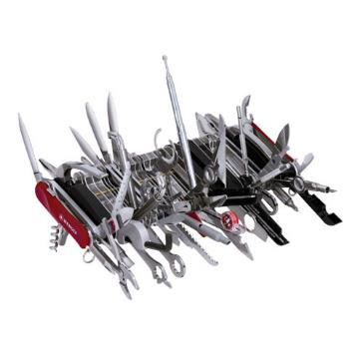
HOW?
Over 100
Partnership
Sessions!
WE NEED A TOOL!!

Slide 46
THE PARTNERSHIP MODEL
Drivers
Decision to
Facilitators
Compelling reasons to
create or adjust
Supportive environmental
partner
partnership
factors that enhance
partnership growth
Components
Drivers set
expectations
of outcomes
Joint activities and processes that build and
sustain the partnership
Feedback to:
Components
l
Drivers
l
Facilitators
Outcomes
l
The extent to which performance
meets expectations

Slide 47
Assessment of Drivers: Asset / Cost Efficiency
Example
Drivers are strategic factors which result in a competitive advantage and which help to determine the appropriate level of a business relationship. For each driver, circle the boxed number which reflects the probability of your organization realistically achieving a benefit through forming a tighter relationship.
Probability
No Chance
Certain
ASSET/COST EFFICIENCY
0%
25%
50%
75%
100%
1. What is the probability that this relationship will substantially
1
2
3
4
5
reduce channel costs or improve asset utilization?
For example:
-product costs savings
-distribution costs savings, handling costs savings
-packing costs savings, information handling costs savings
-managerial efficiencies
-assets to the relationship
If you rated efficiencies in the shaded area and if the advantage is either a sustainable
1
competitive advantage or it allows your firm to match benchmark standards in your
industry, circle the 1 to the right.
Example:
McDonald’s lowered channel costs by partnering with a distributor.
Source: Douglas M. Lambert, Editor, Supply Chain Management: Processes, Partnerships, Performance, Fourth Edition, Ponte Vedra Beach , FL: Supply Chain Management Institute, 2014, p. 28

Slide 48
Assessment of Facilitators:
Corporate Compatibility
Example
Facilitators are factors which provide a supportive environment for the growth and maintenance of a partnership. For each facilitator, indicate the probability of it being a factor in this relationship, by circling one of the boxed numbers
Probability
No Chance
Certain
CORPORATE COMPATIBILITY
0%
25%
50%
75%
100%
1. What is the probability that the two organizations will mesh
1
2
3
4
5
smoothly in terms of:
(a) CULTURE?
For example:
-Both firms place a value on keeping commitments
-Constancy of purpose
-Employees viewed as long term assets
-External stakeholders considered important
(b) BUSINESS?
For example:
-Strategic plans and objectives consistent
-Commitment to partnership ideas
-Willingness to change
Example:
An engineering culture may not mesh smoothly with a more sales-oriented culture thus causing possible challenges for the two companies efforts to form a partnership.
Source: Douglas M. Lambert, Editor, Supply Chain Management: Processes, Partnerships, Performance, Fourth Edition, Ponte Vedra Beach , FL: Supply Chain Management Institute, 2014, p. 290.

Slide 49

The Strength of the Drivers and Facilitators
Indicate the Type of Partnership
Propensity to Partner Matrix
DRIVER POINTS
 | 8-11 Points | 12-15 Points | 16-24 Points
8-11 Points | Arm’s Length | Type I | Type II
12-15 Points | Type I | Type II | Type III
16-24 Points | Type II | Type III | Type III
FACILITATOR
POINTS
Source: Douglas M. Lambert, Editor, Supply Chain Management: Processes, Partnerships, Performance, Fourth Edition, Ponte Vedra Beach , FL: Supply Chain Management Institute, 2014, p. 291.

Slide 50
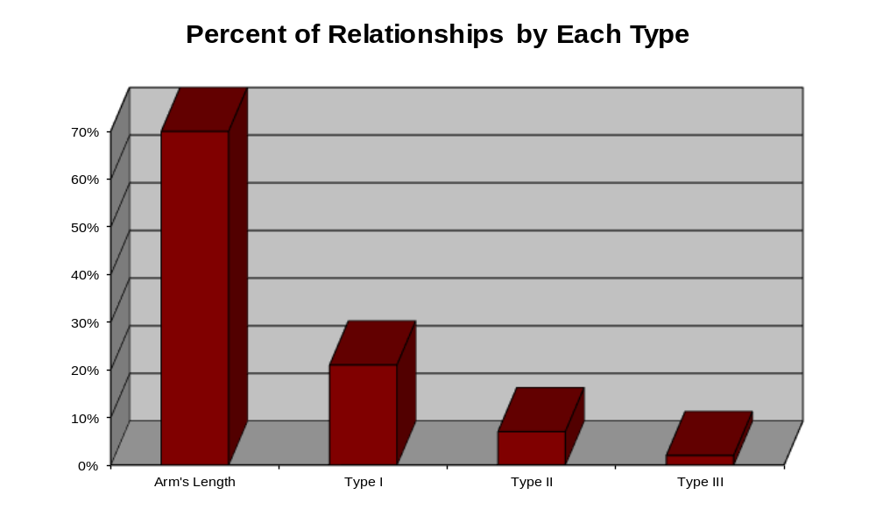
Relationship Segmentation Guide
Source: Lambert, Douglas M., Margaret A. Emmelhainz, and John T. Gardner, “So You Think You Want a Partner?”, Marketing Management, Vol. 5, No. 2 (1996), p. 29.

Slide 51
RESULTS
The process supported efforts to establish commonly specified materials and production for global use - $2.5M annual savings
The process supported the establishment of a vendor managed supply model - $4.3M annual savings
The process supported efforts to restructure supply network - $2.8M annual savings
The process supported a dramatic increase in innovation - helped us to establish gating process with suppliers to select best executable ideas
Created a more trusting environment - “I was pleasantly surprised . . . Before the meeting, I thought that you were going to “Beat Me Up” on price . . . The process was balanced and definitely improved our relationship”

Slide 52
Conclusions
Partnerships are not appropriate in all situations.
General guidelines exist to determine if a partnership is appropriate.
Different settings require different types of partnering.
The appropriate partnership can improve performance of both firms.
© Supply Chain Management Institute. Source: Supply Chain Management: Processes, Partnerships, Performance.

Slide 53
Enablers of SCM Implementation (17 of 22)
Enhanced visibility and communication:
  Computing power and the Internet affect the supply chain
    Mathematical models that maximize shareholder wealth or minimize costs

Slide 54
Enablers of SCM Implementation (19 of 22)
Enhanced visibility and communication:
  Supply chains depend on huge quantities of real-time information
  Retail point-of-sale information can be transmitted directly to suppliers and translated into orders for replenishment of product
  Vendors may allow customers to query vendor inventory records to determine what products are in stock and where the stocks are located

Slide 55



Figure 3: Information Supplied by the Truck Driver Is Recorded and Then Transmitted by the Small Computer
or
Source: Fotolia

Slide 56
Enablers of SCM Implementation (21 of 22)
Supply chain facilitators:
  Logistics outsourcing has the potential to improve both the effectiveness and efficiency of supply chains but can easily result in failure due to:
    Unreasonable and unrealistic expectations
    Lack of flexibility in the relationship

Slide 57
Barriers to SCM Implementation (1 of 2)
Regulatory and political considerations
Lack of top management commitment
Reluctance to share, or use, relevant data
Incompatible information systems
Incompatible corporate cultures
Globalization challenges

Slide 58
Barriers to SCM Implementation (2 of 2)
Globalization challenges
  Increasing globalization
    Lower-priced materials and labor
    Global perspective of companies
    Development of global competition
  Extremely difficult to integrate due to differences
    Cultural, economic, and technological
    Political, spatial, and logistical

Slide 59
Supply Chain Integration
Long-term, mutually beneficial agreements
  Partnerships
  Strategic alliances
  Third-party arrangements
  Contract logistics
Methods used to integrate
  Vertical integration
  Formal contracts
  Informal agreements

Slide 60
SCM Specialization
SCM 610 – Supply Chain Collaboration
SCM 620 – Strategic Supply Management
SCM 630 – Supply Chain Planning
SCM 640 – Distribution Management
Only opportunity for 2020 starts in January @ Spectrum Campus
Check with your Advisor for scheduling.

Slide 61



Review – the Evolution of SCM in the Professional World
SCOR Model of SCM
Source → Make → Deliver
Certifications:
SC Pro® -- www.cscmp.org
CPIM, CSCP, CLTD – www.apics.org
CPSM, CPSD – www.instituteforsupplymanagement.org

Slide 62

Reminders
Assignment
  Final Project
    Report
    Analysis
    Presentation
Final Exam
#1 – Course Feedback due Friday night!
#2 – Peer feedback and Self-assessment due Sunday night!

